Slide 1




PORTFOLIO MANAGEMENT
- OPTION B -
GROUP 2
CHEN WEI / FENG JIA YI / INSANUALA KHULUQIN KARIM

Slide 2

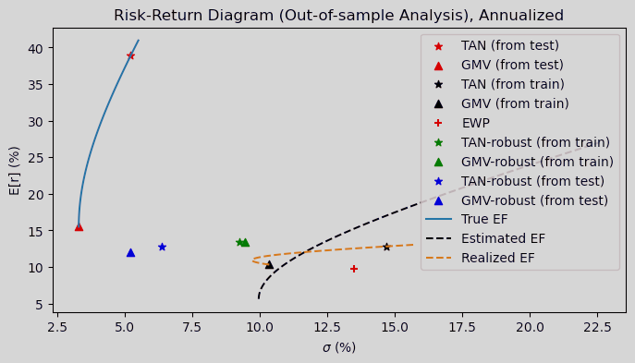
DATA SETTING
Financial Crisis on 1986-2010
Recovery Time and New Challenges on 2011-2015
The excess return on the market portfolio (Mkt-RF)
The riskless return rate (RF)
The monthly return of 43 industry capital-weighted portfolios
PORTFOLIO STRATEGIES
Constructed by 2005-2015 data
to be evaluated on the 2016-2020

Slide 3
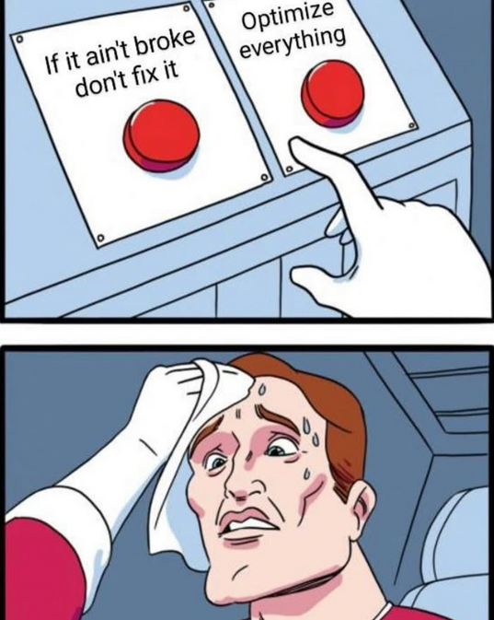

APPROACH 1
- LLM
Pipeline Flow:
stats tool
split data
iterate
methods
backtest
reflect
Methods Iterated:
Performance Matrix:
sharpe optimization
mean-variance optimization
black litterman optimization
equal weight baseline
 | sharpe | mean-variance | black litterman | equal weight
Exp. Return (%) | 11.9 | 14.89 | 8.4 | 8.56
Std(%) | 11.74 | 15.3 | 11.54 | 17.52
Sharpe Ratio | 1.01 | 0.97 | 0.73 | 0.49
Future:
Easy extension
Dynamic manipulation

Slide 4
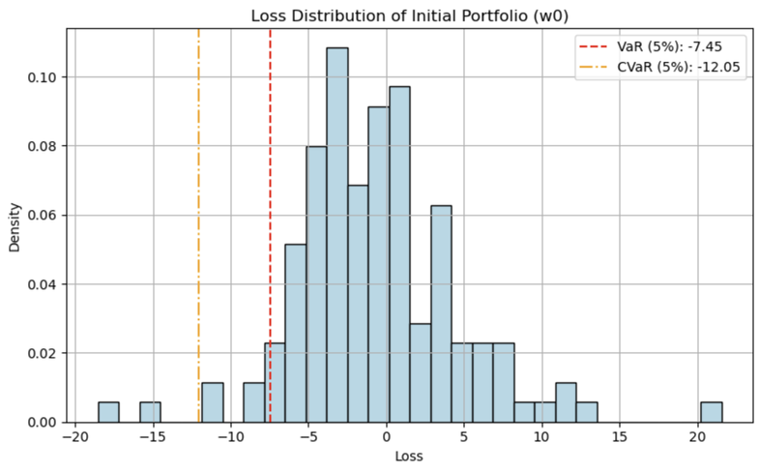
APPROACH 2
- CVaR Optimization
Motivation:
Loss distribution of market weights from 2005-2015 showed significant tail risk.
Objective:
Minimize expected shortfall (CVaR) at the 5% significance level.
Constraints:
Performance Matrix
 | MKT | EWP | TAN-Robust | GMV-Robust | CVaR-Min
Exp. Return (%) | 7.636 | 9.775 | 14.452 | 14.453 | 18.271
Std(%) | 15.535 | 13.592 | 7.701 | 7.835 | 9.184
Sharpe Ratio | 0.492 | 0.718 | 1.874 | 1.842 | 1.987
Weights sum = 1
Monthly portfolio volatility <= 3%
Exp. return >= monthly market return

Slide 5
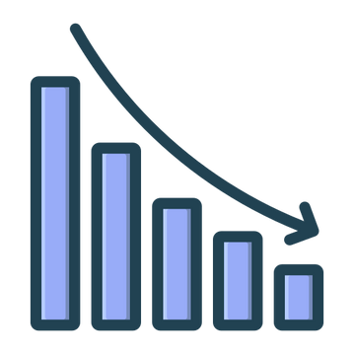
RECOMMENDATION
Beyond the European Debt Crisis and 2013 Taper Tantrum,
more was happening in 2015...
 | TAN-Robust | LLM | CVaR-Min
Mines | -0.025988% | 0.0000% | 0.0615%
Coal | -0.013277% | 0.0000% | -0.0694%
Oil | 0.064032% | 0.0548% | 0.0477%
Notable decline in commodity prices, impacting oil, gas, and mining
CVaR-Min has the lowest weight on Oil !

